Slide 1
Identification Of Diabetic Retinopathy Using CNN
Guide name:
Dr . C. R. K. Reddy
(HOD)
A. Priyanka
16261A0501

Slide 2
Content
Introduction
Problem Definition
Proposed System
Modules
Algorithm
Design Methodology
Results
Conclusion
References

Slide 3
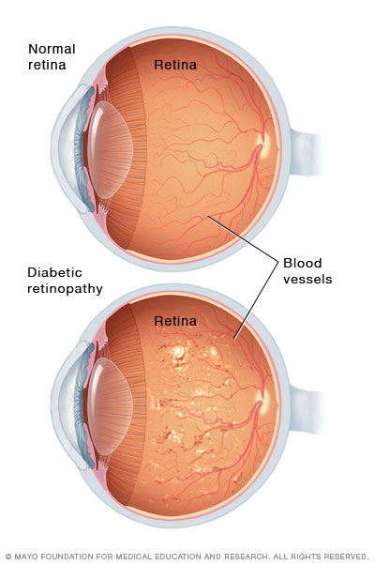
Introduction
Diabetic Retinopathy(DR) is a medical condition in which damage occurs to the retina due to diabetes mellitus.
It is also a leading cause of blindness in the active population.

Slide 4
Problem Definition
The number of people diagnosed having diabetes has increased dramatically over the last several decades, and diabetes increases the risk of a range of eye diseases, of which diabetic retinopathy is one of the most severe.
Moreover, diabetic retinopathy is the main cause of blindness in the mid-age population. Despite sustained efforts having been made, early detection of diabetic retinopathy is a time-consuming process even for a well–trained clinician, which may result in delayed treatment, miscommunication, etc.
The importance of an automatic method for diabetic retinopathy detection has been recognized to identify the diseases in time and accurately.

Slide 5
Proposed System
Creating a network using CNN algorithm where we are going to detect even the tiny vessels that are used in the post-processing step to remove the noise pixels from the background.
By that we can get an accurate detection of retinal blood vessels of DR effect image.

Slide 6
MODULES
CNN Model consists of two types of modules. They are
Feature Extraction Module: It is combination of convolutional and pooling layers to extract the high-level -features.
Classifier Module: It uses several full connection layers as a classifier

Slide 7
ALGORITHM
CNN(Convolutional Neural Network) is a deep learning algorithm which takes input as images, assigns the importance to various objects in the images, differentiate one from other using different layers and gives an output.
The layers are organized in 3 dimensions: width, height and depth. Further, the neurons in one layer do not connect to all the neurons in the next layer but only to a small region of it. Lastly, the final output will be reduced to a single vector

Slide 8
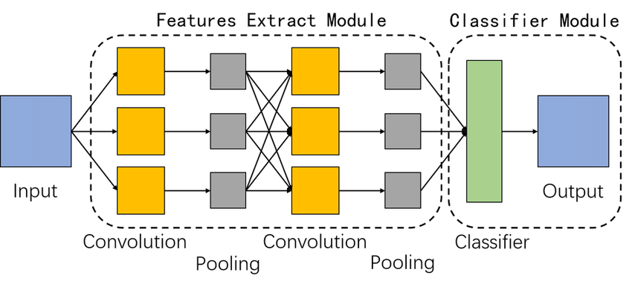
Design Methodology
System Architecture of Application
System basically uses jupyter note book to import the input as images and give those input images to the feature extraction module(i.e. convolutional layer and pooling layer) after feature extraction it transfers the data to classifier module(i.e. fully connected layers, SoftMax layer) which performs classification and gives output respectively.

Slide 9

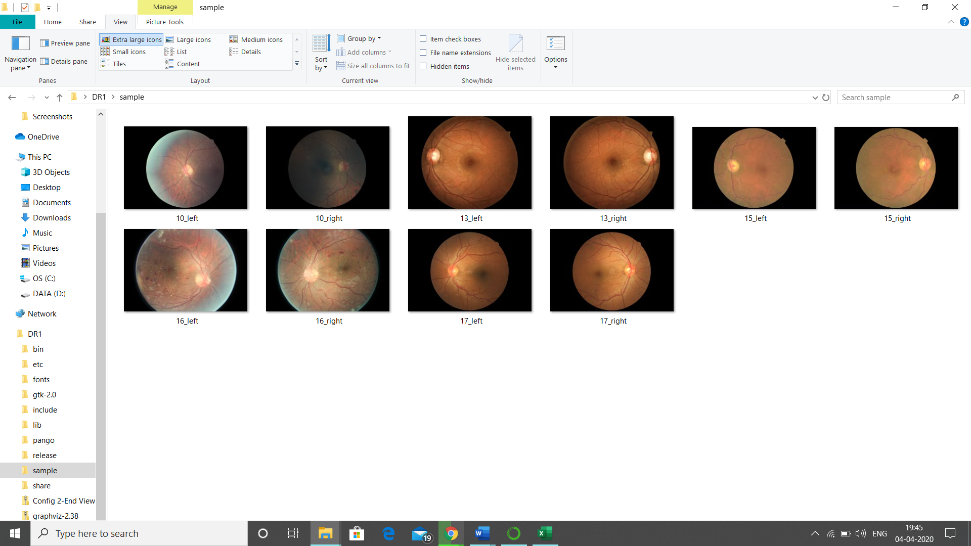
1.Data Sets
The data set used is a diabetic retinopathy data set. It is publicly available in Kaggle.com website.
There are two types of data set one data set contains images of retina from both left and right eye and the other dataset is a .csv file with 5 class groups i.e: normal, mild DR, moderate DR, severe DR, and proliferative DR classes in the form of 0,1,2,3,4 respectively.
16_right 3
Images of retina of an eye
.CSV file of 5 class groups of retinal image

Slide 10
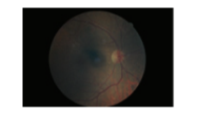
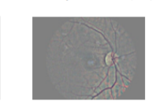
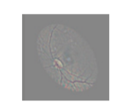
2.Data Preparation
There are two steps in data preparation
Data Preprocessing
Data Augmentation
1. Original Image
2.Preprocessed Image
3.Augmented Image

Slide 11
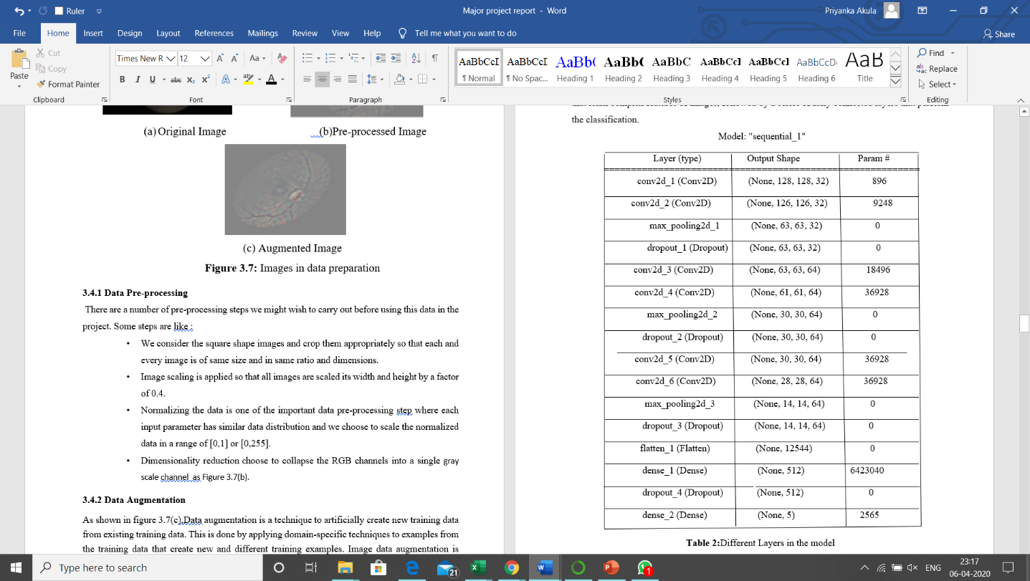
3.Creating a Model
As we are using CNN to create a model it is always composed of a series of convolutional layers and pooling layers that learn complex features of images, followed by a series of fully connected layers that perform the classification
Different layers in model

Slide 12
RESULTS
In order to test a data first we have to train the data set using a CNN model. After training the dataset with the model we have to test the dataset with same model and check the accuracy value. If we get high accuracy in testing then that module can be used further.
First divide the data in to 75:25 i.e. we train the network using 75% of data and remaining 25% data is used to test the network.

Slide 13
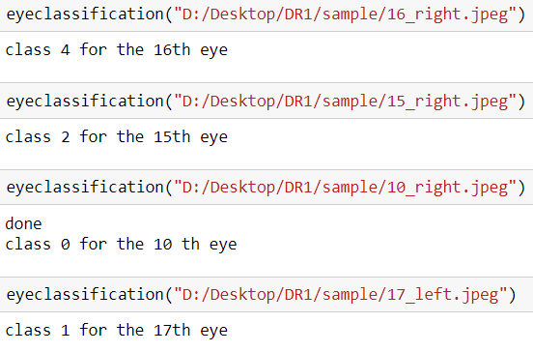
In testing process as we are giving images as input, we have created a method named as eye classification to check whether each and every image is in same format and in same size if not, we have to convert them in to same size and format and we create a path for every image.
Using this eye classification method, we have to give the path of a retinal image which gives the output as the class of that retinal image i.e. the level of infection present in that retinal image of a person.
These are test data values:
Class 2 for the 15th eye.
Class 0 for the 10th eye.
Class 4 for the 16th eye.
Class 1 for the 17th eye

Slide 14
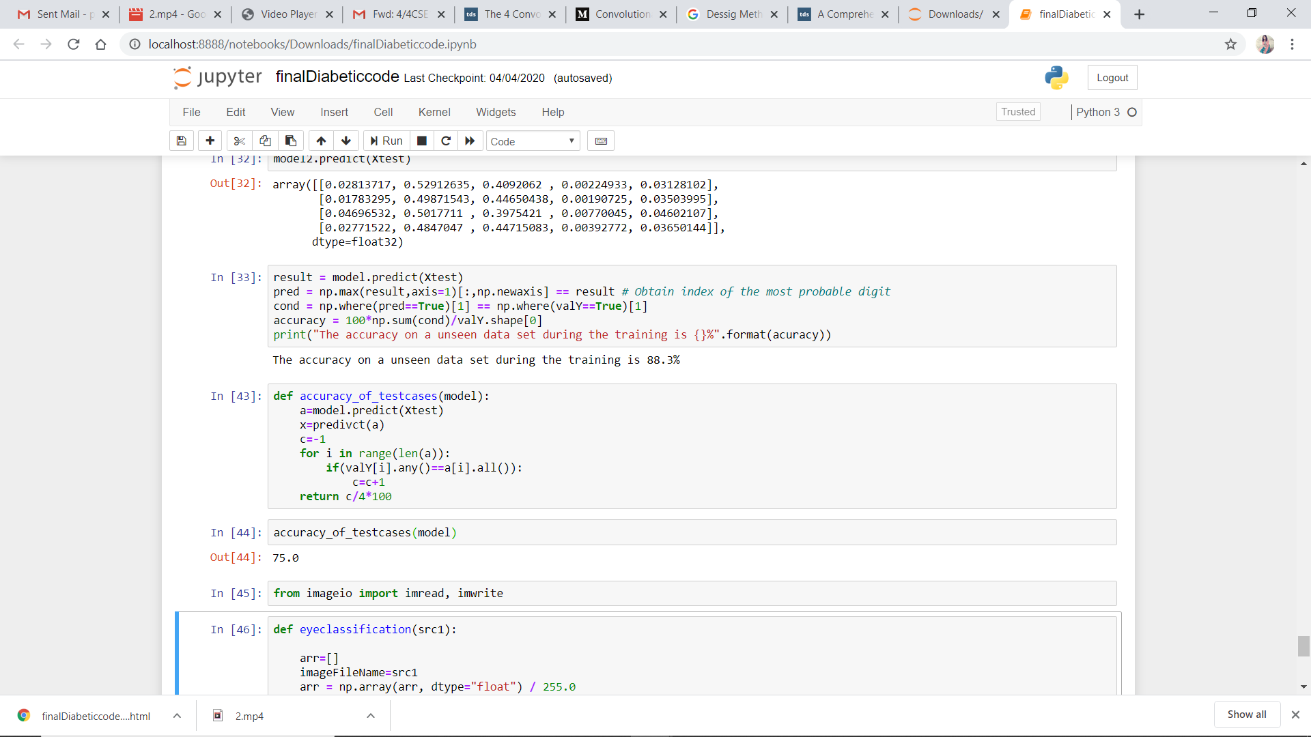
As we know that calculating the accuracy is very important to measure the performance of the model. To measure the accuracy, we have to create a method where it takes the model and gives accuracy value.
(accuracy = (correctly predicted class(tp+tn) / total testing class(p+n)) × 100%) in the form of percentage
for the both training and testing data values[5].
The accuracy on a dataset during training is 88.3%.
The accuracy on a dataset during testing is 75%.

Slide 15
Conclusion
The objective of forming this “Identification Of Diabetic Retinopathy Using CNN” network is successively achieved by detecting the disease accurately .
By forming a network that handles the noisy pixels will give better visualization of retinal blood vessels and it will be easier for the ophthalmologist to diagnose a disease and recommend proper treatment.

Slide 16
Video Showing Execution of project
The below link is used to show the execution of project in Anaconda Navigator using jupyter notebook
https://drive.google.com/open?id=17a8Rs16V91uuKi9qBHzxPDPrIBXd42kz

Slide 17
REFERENCES
[1] Toufique Ahmed Soomro, Ahmed J. Afifi, Lihong Zheng, Shafiulla Soomro, Junbin Gao, Olaf Hellwich and Manoranjan Paul,” Deep Learning Models for Retinal Blood Vessels Segmentation: A Review”, Received May 7, 2019, accepted May 24, 2019, date of publication June 3, 2019, date of current version June 12, 2019.
[2] Ryan J. Fante, BS, Vikram D. Durairaj, MD,Scott C.N. Oliver,” Diabetic Retinopathy: An Update On Treatment”,The American journal of medicine 2010.
[3] A. Krizhevsky, I. Sutskever, and G. E. Hinton, ‘‘ImageNet classiﬁcation with deep convolutional neural networks,’’ in Proc. Conf. Adv. Neural Inf. Process. Syst., 2012, pp. 1097–1105.
[4] Thomas Walter, Jean-Claude Klein, Pascale Massin, and Ali Erginay, A Contribution of Image Processing to the Diagnosis of Diabetic Retinopathy—Detection of Exudates in Color Fundus Images of the Human Retina, IEEE transactions on medical imaging,vol 21,NO.10,October 2002.

Slide 18
Thank You

